Slide 1
Corrosion control
By Bhavik Champaneria-T74
& P. M. Prabhakara-T48
Faculty name: Patel dipsa
Institute name: Food procrssing technology department
A.D.patel institute of technology
Karamsad

Slide 2
Various corrosion control methods
Proper designing
Using metal alloys
Cathodic protection
Use of inhibitors
Application of protective coatings

Slide 3
Proper designing
The design of the material should be such that “corrosion even if it occurs, is uniform and does not result in intense and localized corrosion.
Important design principles:
Avoid the contact of dissimilar metals in the presence of a corroding solution.
Anodic metal should not be painted or coated.

Slide 4
Using metal alloys
Corrosion resistance of most metals is best increased by alloying them with suitable elements, but it should be taken care that alloy is completely homogeneous..

Slide 5
Cathodic protection
The principle involved in this method is to force the metal to be protected to behave like cathode, thereby corrosion does not occur.
There are two types of cathodic protections:
Sacrificial anodic protection method
Impressed current cathodic protection

Slide 6
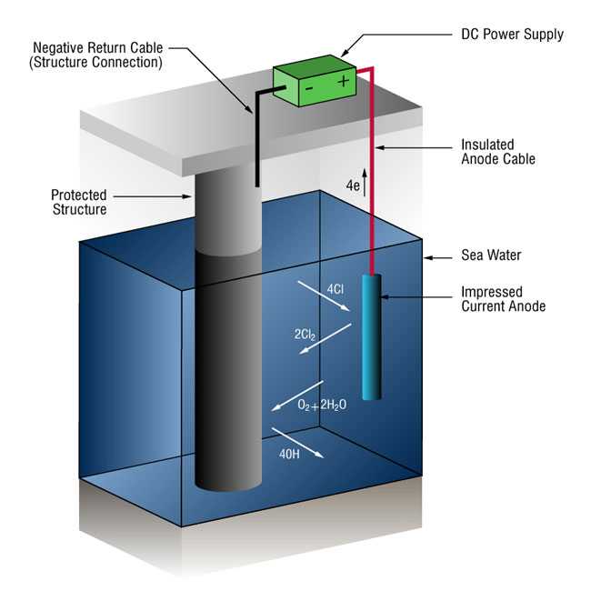
Impressed cathodic protection

Slide 7
Use of inhibitors
A corrosion inhibitor is a substance which when added in small quantities to the aqueous corrosive environment, effectively decreases corrosion of a metal
Inhibitors are of basically two types:
Anodic inhibitors: they stifle the corrosion reaction, occurring at the anode, by forming a sparingly soluble compound with a newly produced metal ion, which could adhere to metal. ex: chromates, phosphate, etc

Slide 8
Cathodic inhibitors:
In acidic solution : they slowdown corrosion by slowing down the diffusion of H+ ions to the cathode. Ex: amines, mercaptans, heterocyclic nitrogen, etc.
In natural solution : in this reducing agents act as inhibitors, they eliminate oxygen from the corroding medium or by retarding its diffusion to the cathodic areas

Slide 9
Application of protective coatings
In this a coating insolates the underlying metal from the corroding environment.
The only necessary conditions for this are
The coating applied must be chemically inert to the environment under particular conditions of temperature and pressure.
Coatings must prevent the penetration of the environment to the material, which they protect.

Slide 10
Types of protective coatings
Anodic coatings:
This is done by coating metals which are anodic to the base metal. For example coating of Zinc, Al, Cd on steel. The coatings done are anodic , because their electrode potentials are lower than that of the base metal. If any pres, breaks or discontinuities occur in such an anodic coating, a galvanic cell is formed between the coating-metal and the exposed part of base metal. Thus no attack on base metal occurs, until practically all the zinc has first corroded in the vicinity of the exposed iron spot. So, the coating-metal protects base metal sacrificially

Slide 11
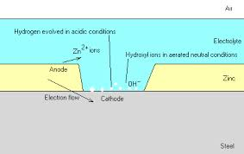

Slide 12
Cathodic coatings:
this is done by coating a metal more noble than base metal. They protect the base metal, because they have higher corrosion-resistance than the base metal. Cathodic coating provides effective protection to the base metal only when they are completely continuous and free from pores, break or discontinuities.
if such coatings are punctured, much or corrosion damages can be done to the base metal than to metal without it.

Slide 13
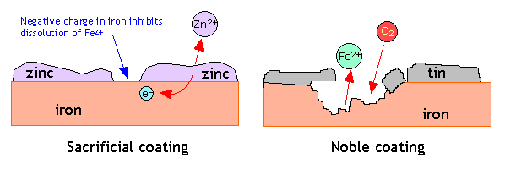

Slide 14
THE END
By FPT
Bhavik(130010114003)
&
P.M.Prabhakara(130010114017)

